Slide 1


By: Ospan Ramazan, Saparbek Ulpan, Abdigali Nurasyl
JSE
Job Search Engine

Slide 2
JSE
Job Search Engine
By: Ospan Ramazan, Saparbek Ulpan, Abdigali Nurasyl
Brief overview of JSE
Key Objectives
1
Comprehensive Tools:
Offer robust, user-friendly platforms tailored for both job seekers and employers.
Includes features like real-time job tracking, customizable job alerts, and detailed employer profiles.
Streamlining Processes:
2
Simplify complex job searching and hiring activities.
Automated matching systems and streamlined communication tools reduce the time and effort needed to connect the right employers with the right candidates.

Slide 3

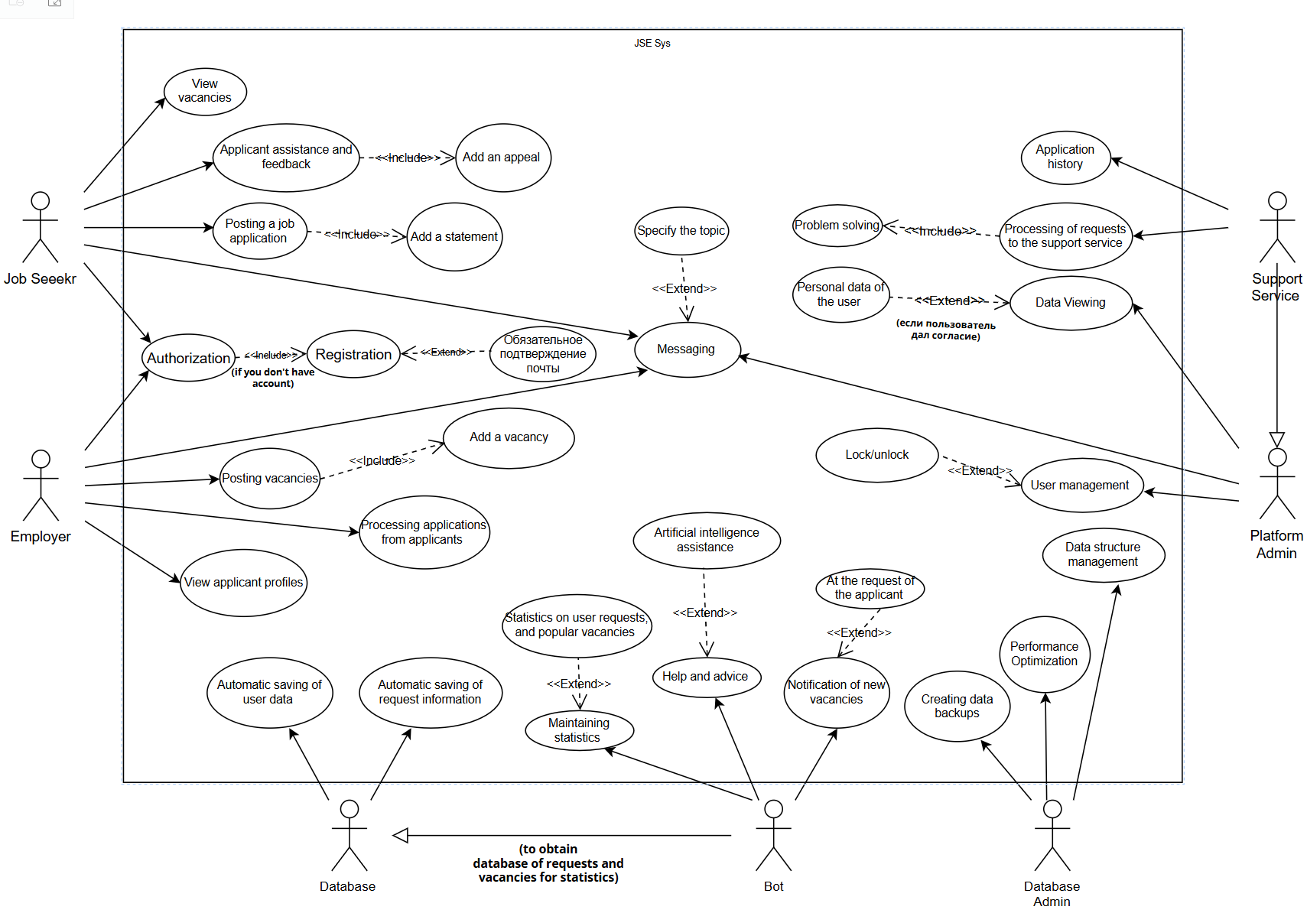

JSE
Job Search Engine
By: Ospan Ramazan, Saparbek Ulpan, Abdigali Nurasyl
Brief overview of JSE
Key Objectives
1
Comprehensive Tools:
Offer robust, user-friendly platforms tailored for both job seekers and employers.
Includes features like real-time job tracking, customizable job alerts, and detailed employer profiles.
Streamlining Processes:
2
Simplify complex job searching and hiring activities.
Automated matching systems and streamlined communication tools reduce the time and effort needed to connect the right employers with the right candidates.
Use Case Diagram

Slide 4
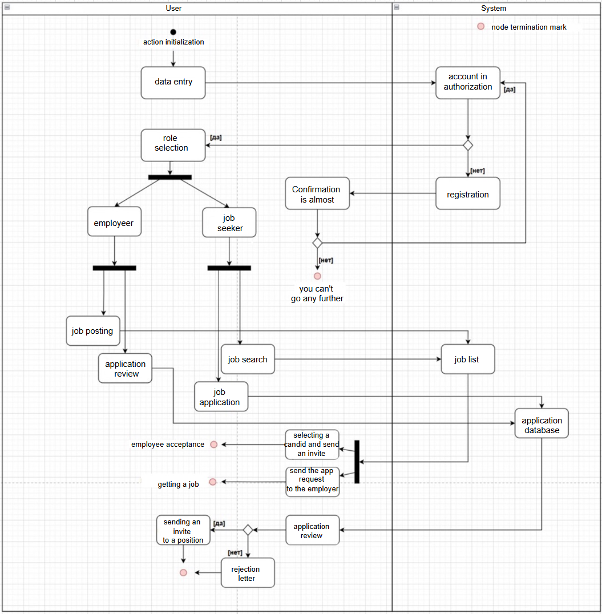
Brief overview of JSE
Key Objectives
1
Comprehensive Tools:
Offer robust, user-friendly platforms tailored for both job seekers and employers.
Includes features like real-time job tracking, customizable job alerts, and detailed employer profiles.
Streamlining Processes:
2
Simplify complex job searching and hiring activities.
Automated matching systems and streamlined communication tools reduce the time and effort needed to connect the right employers with the right candidates.
Use Case Diagram
Activity Diagram

Slide 5
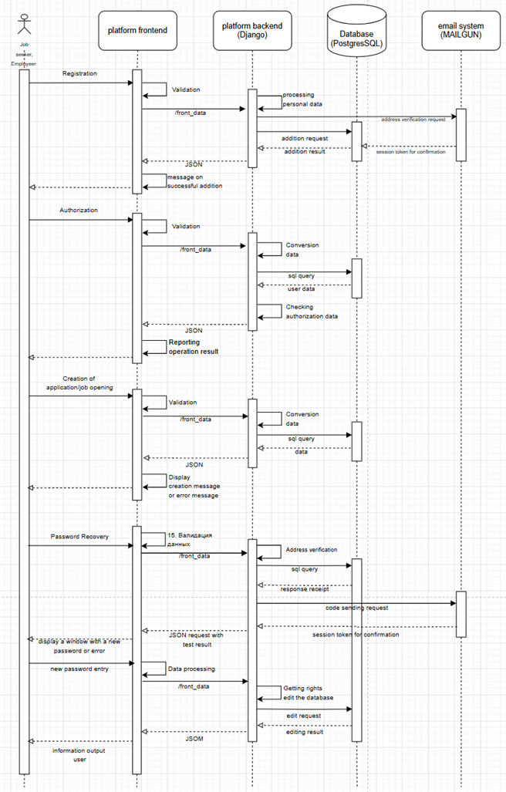
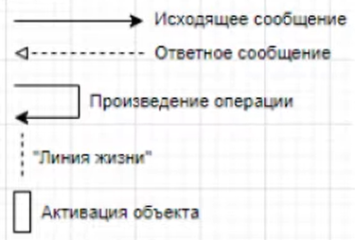
Sequence
Diagram
Use Case Diagram
Activity Diagram

Slide 6
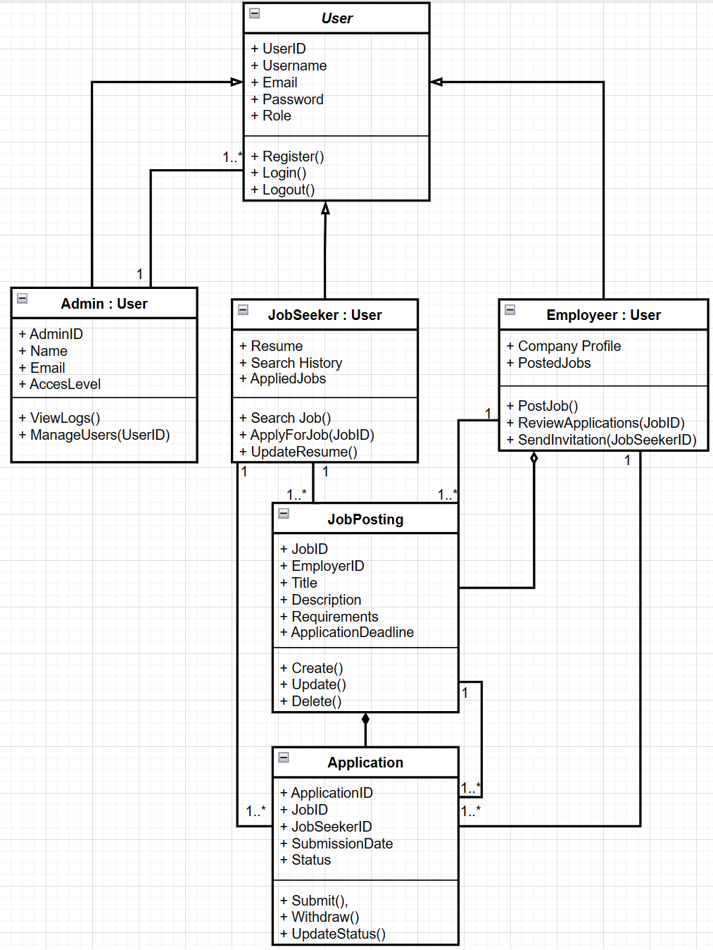
Sequence
Diagram
Class Diagram
Activity Diagram

Slide 7
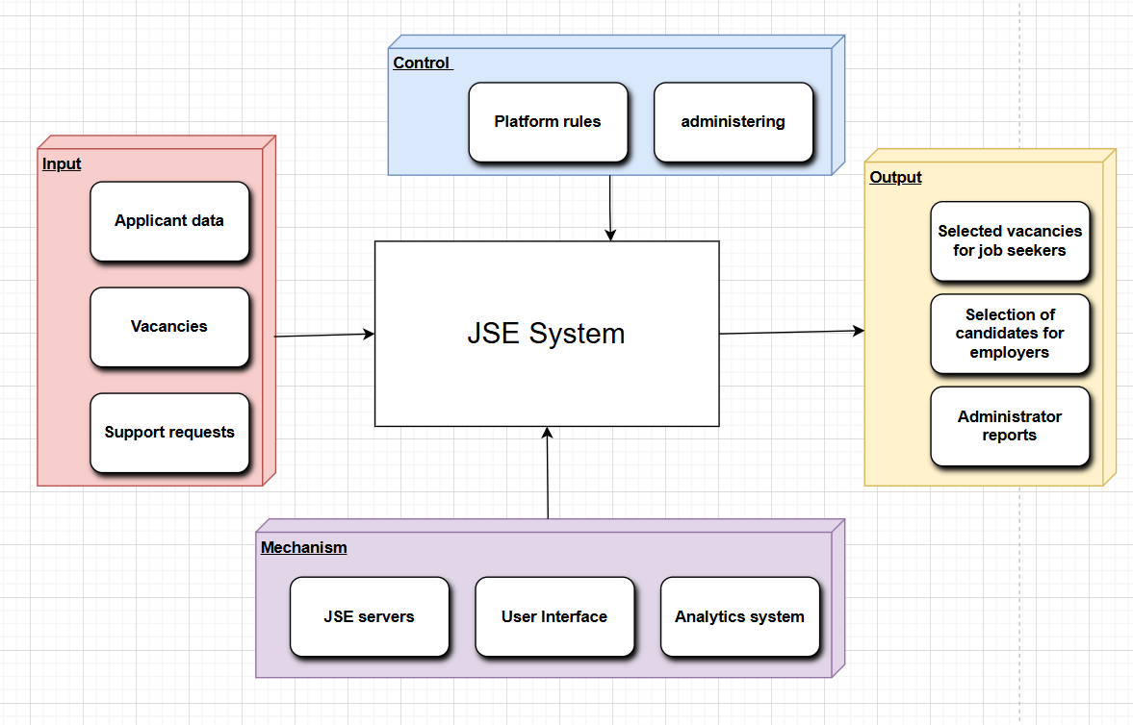
Sequence
Diagram
Class Diagram
Context Diagram
Activity Diagram
Class Diagram

Slide 8
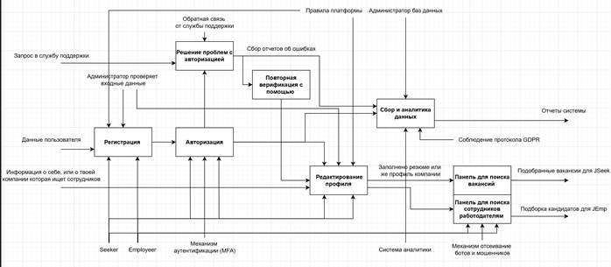
Class Diagram
Context Diagram
Decomposition Diagram

Slide 9
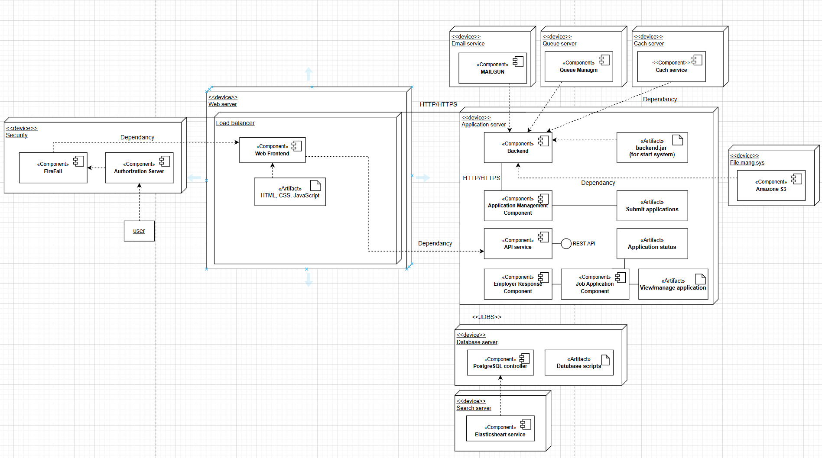



Context Diagram
Deployment Diagram
Decomposition Diagram

Slide 10
Ospan Ramazan
Saparbek Ulpan
Abdigrali Nurasyl
Deployment Diagram
Decomposition Diagram

Slide 11

Context Diagram
Ospan Ramazan
Thank
Saparbek Ulpan
You
Abdigrali Nurasyl
Deployment Diagram
Decomposition Diagram

Slide 12
Context Diagram
Ospan Ramazan
Thank
You
Saparbek Ulpan
Abdigrali Nurasyl
Deployment Diagram
Decomposition Diagram

